Slide 1
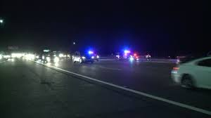
Challenge – Highway Safety and Flashing Lights.
Design, build and test both computer and full scale simulations of highway patrol vehicle light package that optimizes attention without distraction.
Save lives by preventing drivers from rear ending vehicles!
Notes:
You know what I’m talking about – those bright red, white and blue flashing lights on top of a highway patrol car on the shoulder ahead of you. You don’t know what’s going on but you know it’s probably not good. Maybe you’re focusing on those flashing lights and not on the road ahead of you. After all, it’s a common response called ‘phototaxis’. Like moths to the flame we look at the lights and become oblivious to what’s going on behind us and in the adjacent lanes. In fact, in remote stretches of highway, state police officers are killed or injured when cars plow into the rear of the stopped emergency vehicle. Your challenge is to research this phenomenon and design alternative lighting configurations. You’ll need to consider driver behavior, highway conditions, wavelength and frequency of flashing lights and the human visual system, population stereotypes, detection distance, cultural stereotypes and many other variables. Your deliverable phase one output should be a computer simulation that satisfies the requirements and documents the exact configurations and variables. Phase Two involves conducting experiments possibly with a full scale prototype. That is the Challenge.

Slide 2
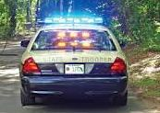
The Problem and Challenge
Flashing lights attract attention, but…
Flashing lights can be distracting and confusing.
For people with epilepsy, flashing or flickering lights can cause a seizure!
Investigate trigger stimuli for epilepsy and “flicker fusion threshold”.
Over a dozen different configurations of flashing lights on patrol cars among states, typically called ‘Mars’ lights.
This project focuses on Rhode Island state highway patrol car configuration.
No apparent coding for the public other than to attract your attention.
People can experience the ‘moth to the flame’ phenomenon (phototaxis); you are attracted to the light.
By attracting your attention flashing lights can contribute to errors in judgment of distance and location of the source of flashing lights, resulting in rear-end collisions, damage and injuries.
Your Challenge – research and develop a better system of alerting drivers
Without drastic modifications to existing light package structure!
Notes:
There’s a lot of confusion about safety vehicles and flashing lights. They attract your attention but there doesn’t seem to be much consistency among emergency vehicles use of flashing lights across agencies and states. However, one state tweaked the intensity by reducing it without adversely affecting rear end accident rates. You need to investigate the best wavelength, intensity, frequency and configuration.

Slide 3
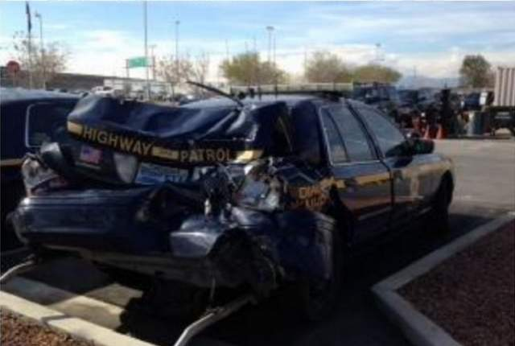
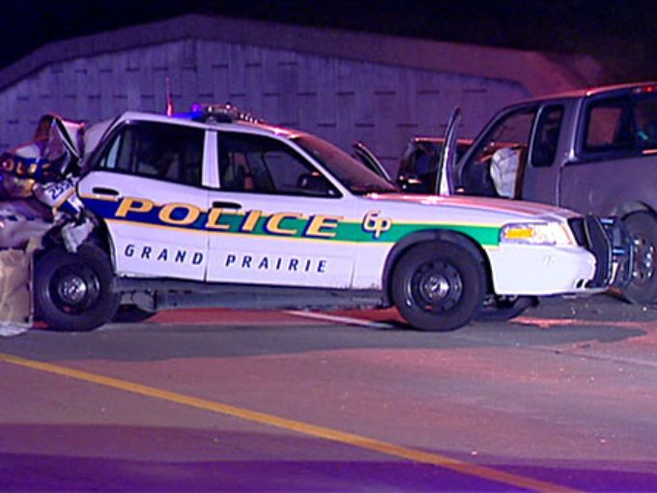
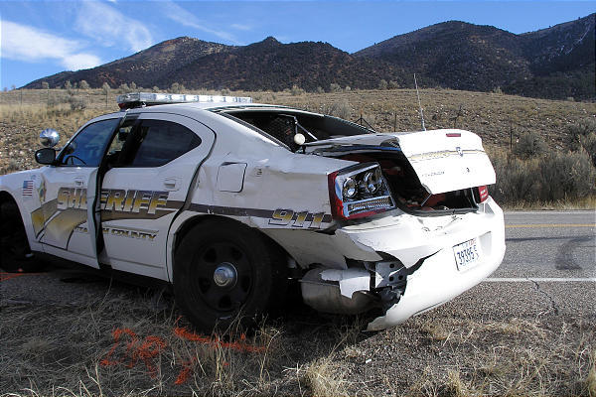
Result of Rear End Collisions

Slide 4
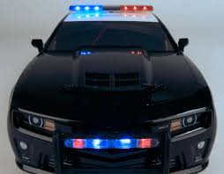
What are some of the variables?
Light coding variables are:
Intensity, location, flash rate, wavelength (color), number.
Color coding stereotypes: status (white), information (blue), warning/caution (orange), danger (red).
Driver variables are:
Physical condition (fatigue, alcohol, drugs, etc.)
Distractions (texting, radio, navigation systems, etc.)
Susceptibility to flashing lights (epilepsy), reaction times
Environmental factors are:
Time of day (daytime vs. night time).
Rain, snow, road configuration (straight-away vs. abrupt curve).
Vehicle variables are:
Windshield clarity, speed of approach, distance to first sighting.
This is very much a ‘human’ project as well as an ‘engineering’ project!
Notes:
Not only do you have the physical characteristics of the lights, but you have driver characteristics, environmental characteristics (rain, sleet, snow, daylight and night time) that affect your perception of the lights. Since you can’t control all the possible independent variables, you should down select from a prioritized list of different variables and design your experiments based on these top priority ones.

Slide 5
Who uses flashing lights on vehicles?
Highway state patrol cars
Municipal and town police patrol cars
Ambulances
USPS delivery trucks
Tow trucks
Utility vehicles (power, telephone)
Fire and public safety vehicles
Sanitation vehicles
School buses
Do flashing lights on these vehicles improve ‘situational awareness’?
Notes:
Here’s just a sample list of the many vehicles that use flashing lights for some reason. Investigate some to understand why and when these vehicles use flashing lights. Do they improve situational awareness? Do they cause an observing driver to be more cautious? Do they direct your eyes (and attention) to the flashing lights or to the impending action like a door opening or vehicle stopping? What is the purpose of these flashing lights on each of these vehicles?

Slide 6
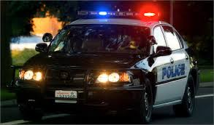
The Capstone Project
Conduct research and isolate most critical variables on page 4.
Investigate what European safety vehicles use to alert drivers.
Search Google: “highway patrol flashing lights”.
Research what experiments done to date on flashing lights on patrol cars, especially Florida.
http://www.hendonpub.com/resources/article_archive/results/details?id=3959
Research the uses, constraints and limitations of flashing lights on town, municipal and state police vehicles, especially state highway patrol cars in Rhode Island.
In 2015, a ProJo article reported changing the intensity of lights. A follow-up call said ‘flashing was adjusted to flicker’. Both? What are the effects?
Develop and test computer simulations of light packages.
Establish a baseline of current lighting configuration; experiment with alternatives.
Conduct a full-scale hardware simulation.
Report results to Rhode Island State Police, Dept. of Training.
Write an APA-style article for publication.
Notes:
Here are some references and more detailed objectives of this Capstone Project. I’ve talked to the Rhode Island Scituate state police barracks in February and they are cooperative in providing some names and numbers to call and discuss this project. Various states have investigated the topic, too, like Florida. And finally, focus on developing some ‘workable’ solutions. That means, based on your experiments, you should be able to recommend adjusting or reconfiguring some subset of highway safety vehicle flashing lights without incurring an enormous cost.

Slide 7
Benefits
Research history and rationale for blinking, flashing lights
Hint – sea coast light houses
Perform systems engineering tradeoff studies.
Experience developing computer simulations of candidate models to test configurations.
Computer generated models and full / partial scale 3D model
Develop test methods using human subjects and identify optimal models consistent with existing state highway patrol cars.
Non-parametric statistics and Likert scale experience a ‘plus’.
Greater familiarity with state, municipal and local community safety issues.
Would be a good project for someone interested in law enforcement career
Greater understanding of human perception and limitations.
Notes:
Here are some of the benefits to working on this project.

Slide 8
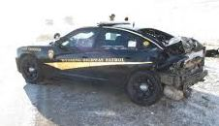
Challenges
Why do state highway patrol cars use red, white and blue flashing lights?
Are there interstate differences in configurations of flashing lights?
What about European emergency vehicles?
Is the flashing sequence a code for first responders?
Why use flashing, blinking and flickering lights?
What colors are most visible at night time? Day time?
Does the sequence and location of flashing lights on patrol cars make a difference?
When vision is degraded (DUI), what effect do flashing lights have on decision making? What about ocular degeneration?
Are there cultural differences in how people perceive flashing lights?
What do people think the flashing lights on patrol cars mean?
Notes:
There are lots of issues to explore in this project. Here is a list of some of the things to investigate. You don’t have to answer all of these questions but it’s a good starting point.

Slide 9
Skills, Roles and Responsibilities
Computer / Hardware Simulation
Computer simulation development
Timing circuits
Rise / decay timing
Replicate environmental conditions
Experimental design and statistical analysis
Human factors engineering
Conducting human-rated experiment.
Good personnel interface skills to work with state police public affairs.
CPE
ELE
Computer Simulation Engineer
Hardware / Software Interfaces
Notes:
Here is a list of some of the skills plus the notional list of majors. I anticipate one (1) CPE (computer engineering) students and one (1) electrical engineering student. The CPE is responsible for developing the computer simulations and conducting experiments on large screen projectors or displays. The ELE student would be responsible for building a full scale or partial scale light package to test timing circuits and understand the electronic systems used by town, municipal and state police now.

Slide 10
Deliverables
Phase One – Research and computer simulation
Research existing systems in US and Europe
Hint: Search YouTube for videos
Research human visual system and environmental variables
Identify System / detail requirements
Hint: Stay within existing US highway safety light package arrangements
Hint: Stay cost effective
Perform Functional analysis and Tradeoff studies
Develop detailed plan for experiments, schedules, resources
Identify some alternatives for lighting alert packages.
Perform some prototyping / demonstration (PC or projector)
Perform some preliminary experiments with human subjects.
Hint: Identify target population, population at risk, etc.
Interim report
Phase Two – Full scale demonstration and validation
Develop full scape prototype
Perform experiments, iterate design, experiment
Demonstrate design to RI agencies, iterate design
Final report
You will perform human-rated experiments using non-parametric statistics and tools.

Slide 11
Notional Bill of Materials
Item | Supplier | Cost ($)
LED array |  | $100
Support structure
Wiring, connectors
Electronic timing breadboard
Tablet or laptop | Team donation
Simulation software | Open source
Eye Tracking software for smart phone | License | $99
Total

Slide 12
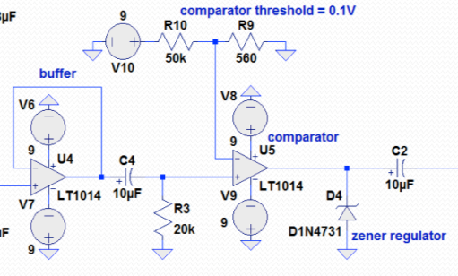
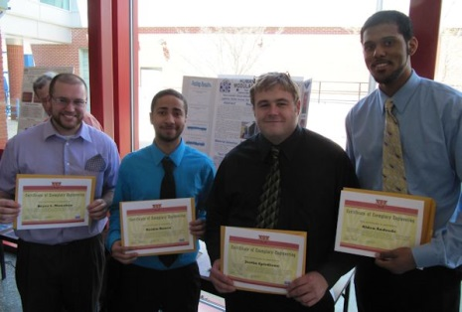
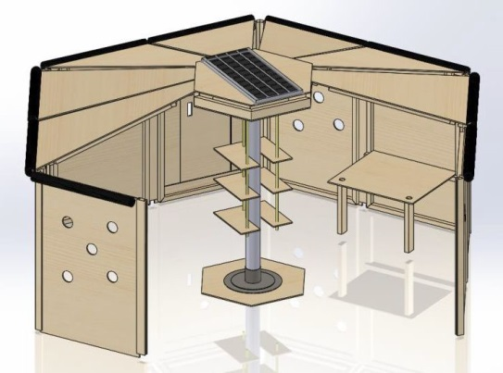
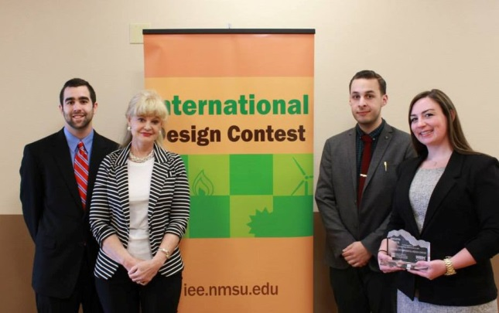
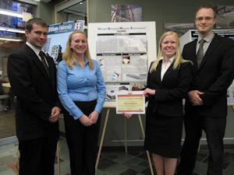
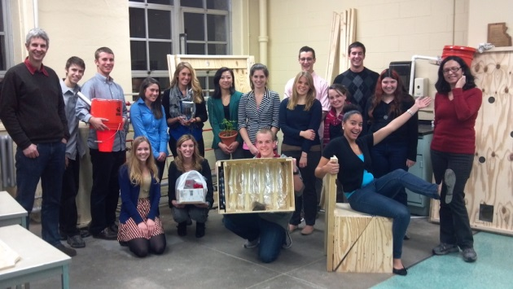
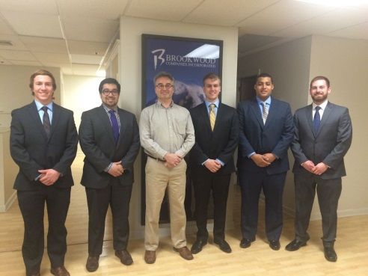
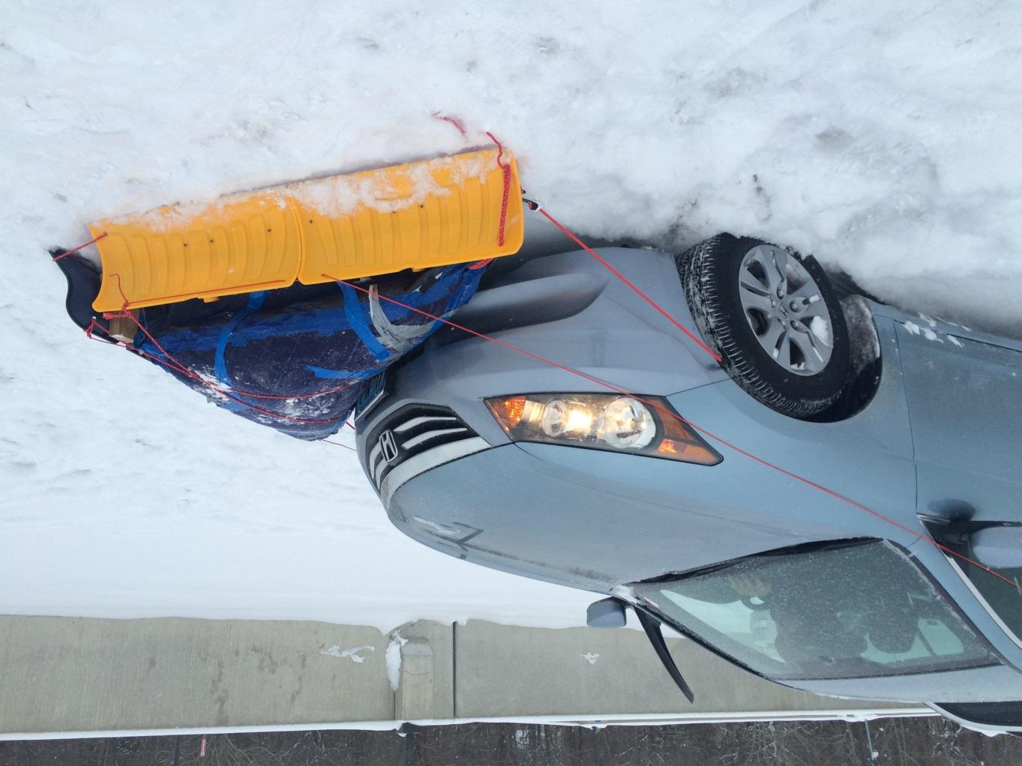
Capstone projects I’ve sponsored
HOME Shelter
URI
CircuiTree
RWU
RWU
URI
InstaPlow
RWU
Notes:
I sponsor Capstone Projects at URI and RWU. Since 2011, I've sponsored 5 College of Engineering projects; the projects are a mix of mechanical and electrical engineering and computer science. Some have won awards at the international level; but all were successful in motivating students to achieve objectives and work in teams. My role is to support the students in systems engineering and problem solving techniques based on my aerospace experience and training.
The HOME Shelter – At RWU in the 2012 ASEE North East Division Conference, the Senior Design Team won 1st place in the poster section and 3rd place overall in the undergraduate division against Yale, Olin and others. Plus, 1st place in RWU Academic Showcase. At URI in 2013, a team of 16 Honors Class university students in HPR “Designing Sustainable Solutions for Developing Communities’ chose the HOME Shelter as their class project. They chose to research and build prototypes of selected subsystems to test compliance to requirements.
CircuiTree – In 2014, the RWU CircuiTree Decay Detector won 2nd place in the Open Category at the NMSU WERC Institute for Energy and the Environment and 1st place in the Peer Award category.

Slide 13
What I do as a Sponsor
Assist developing system and detail requirements.
Assist writing a System Specification, if required.
Attend any team meetings.
Offer advice on systems engineering, analytic tools, methods, metrics, progress, etc.
Review any reports.
Conduct reviews
Requirements, concept and design
Notes:
I work with the team of students by defining some high level requirements, maybe 5 – 10 requirements that we track throughout the project. Each high level system requirement might be broken down into lower level requirements. For instance, if I suggest that we use coding to indicate severity, then I would point students to population stereotypes of color, line, and shape coding elements of the display to attract user attention. I attend most meetings either face to face or FaceTime. FaceTime is very effective and inexpensive compared to driving back and forth to Bristol once a week or every couple of weeks. I review any reports and offer suggestions on how to improve content or flow of the report.

Slide 14
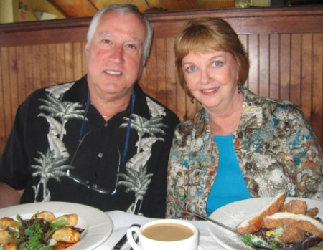
My Background
BA (Psychology, Biology), URI, 1971.
MA (Engineering Psychology), NMSU, 1974.
Senior Staff Human Factors and Systems Engineer, Lockheed Martin, Sunnyvale, CA, 1974-2007.
Applied human factors engineering principles and design standards to mobile shelters, large facilities, missiles, ships, planes, spacecraft, command centers, equipment racks and consoles, transportation systems, handling fixtures, railcars, support equipment, and computer human interfaces.
Worked with mechanical and electrical engineering, systems engineering, manufacturing, training, logistics, parts, materials and processes, facility and field engineering and DOD customers and suppliers.
Taught Specialty Engineering, CONOPS, HFE classes.
Certified Human Factors Engineer #529.
Retired 2007 after 33 years in aerospace industry.
Married Julie Yingling (URI 1970) September 2008.
Moved to West Kingston, November 2008.
Rick and Julie at Turtle Soup.
Notes:
I started out in the URI College of Engineering but couldn’t quite understand all those forces and vectors in statics and dynamics. I passed slide rule and math but I flunked statics and decided engineering wasn’t my calling. I was graduated in 1971 with majors in psychology and biology, and minors in stat and speech and hearing. Al Lott recommended I get a graduate degree at NMSU because it was far away from home, had a low student/faculty ratio, and the profs were from great universities. So I tried ‘engineering psychology’ which focuses on understanding the capabilities and limitations of humans and applying that knowledge to the design of equipment, user interfaces, and facilities so they are easy to use. In 1974, I got a job at Lockheed in Sunnyvale, CA and stayed there until 2007. I worked on ships, planes, communication centers, missiles, spacecraft, submarines, health care delivery systems and other things that ‘go bump in the night’. Never a dull moment except between jobs when you’re looking for new work which was pretty often…. I retired in 2007, got married in 2008, and looked for a place to retire. Which turned out to be Rhode Island which is pretty amazing because most people leave RI and don’t retire here. But it’s worked out very well.

